Slide 1
Los Angeles Department of City Planning Virtual Scoping Meeting
130 College Street Project
110-130 W College St, 117-119 W Bruno St, and 943-973 N Main St
Case No. ENV-2023-2307-EIR
June 12, 2024

Slide 2
Agenda and Objectives
Scoping Meeting Purpose
Project Overview
Overview of City’s Review Process
Draft EIR Scope and Contents and Requested Entitlements
How to Submit Public Comments
Questions & Answers
Note: No decisions on the Project will be made during the Scoping Meeting

Slide 3
Purpose of Scoping Meeting
First step in Project’s environmental review timeline with the City
Provides an opportunity for the City to answer stakeholder questions on the scope and content of the environmental analysis
Informs stakeholders of topics to be analyzed in a subsequent Draft Environmental Impact Report (Draft EIR), typically released 6+ months later
Intended to gather information or knowledge of environmental conditions from stakeholders, including agencies and community members, which may not be well known or may have been omitted
Not intended to solicit feedback on design, appropriateness of land use action, or whether a project should be approved or not
The first of multiple opportunities for public input

Slide 4
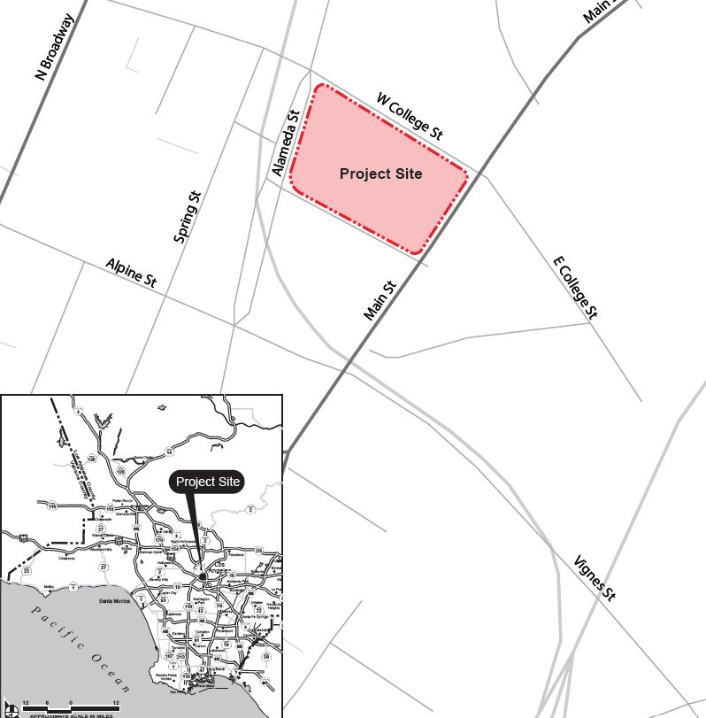
Project Location

Slide 5
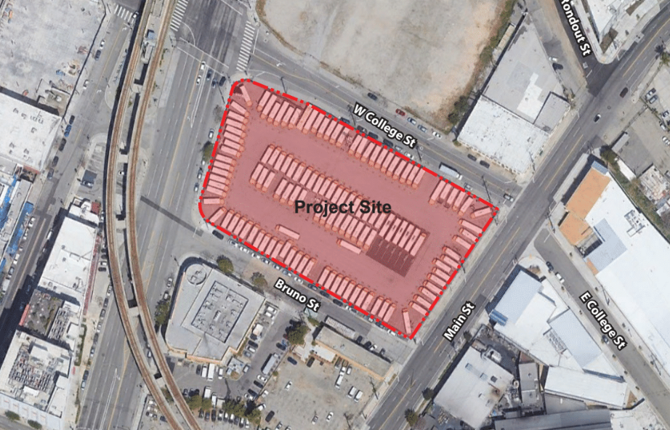
Aerial View of Project Site
Metro A Line Stop to the North
Proposed Mixed-Use Residential Project
Office and Residential Uses
N Alameda St
Mill St
New mixed-use building
Elevated Metro Line
Warehouse uses
6th St
1, 2, and 3-story buildings
Homeboy Industries
Alameda St

Slide 6
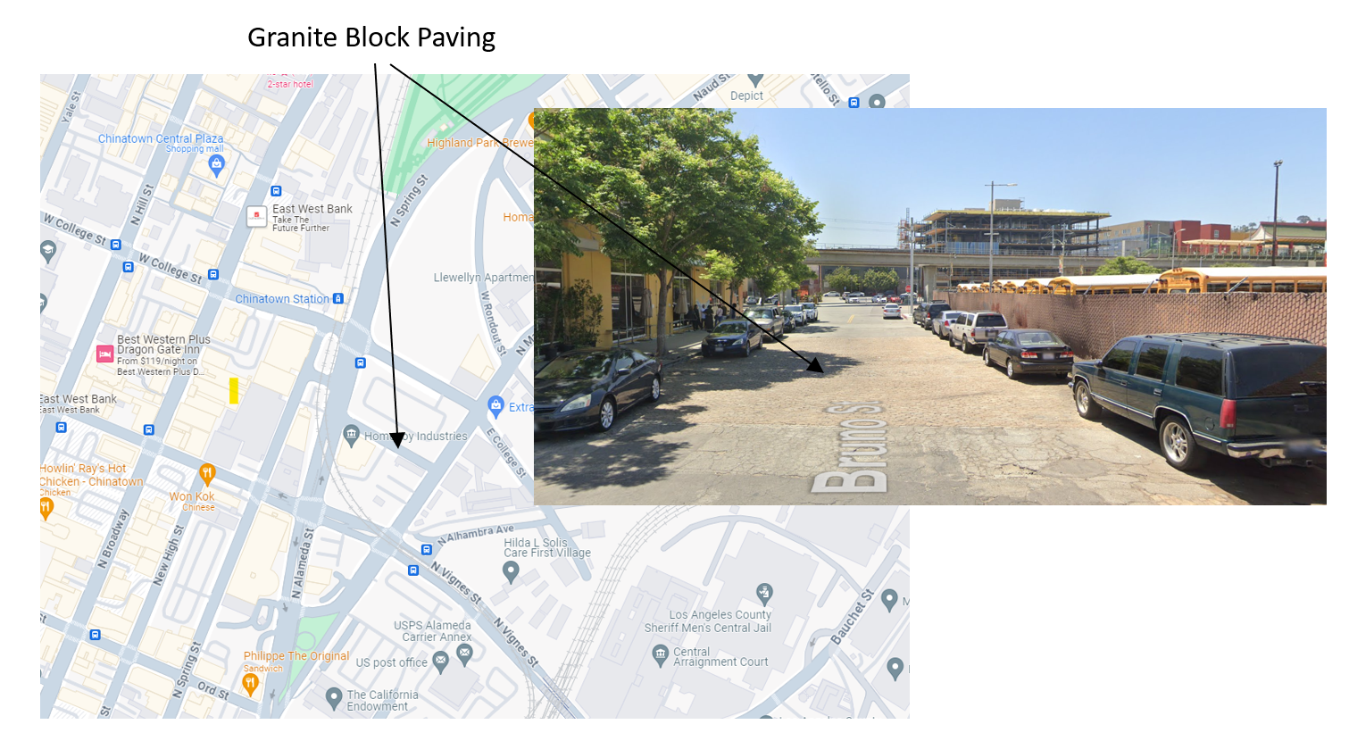
Granite Block Paving
View from Bruno Street

Slide 7
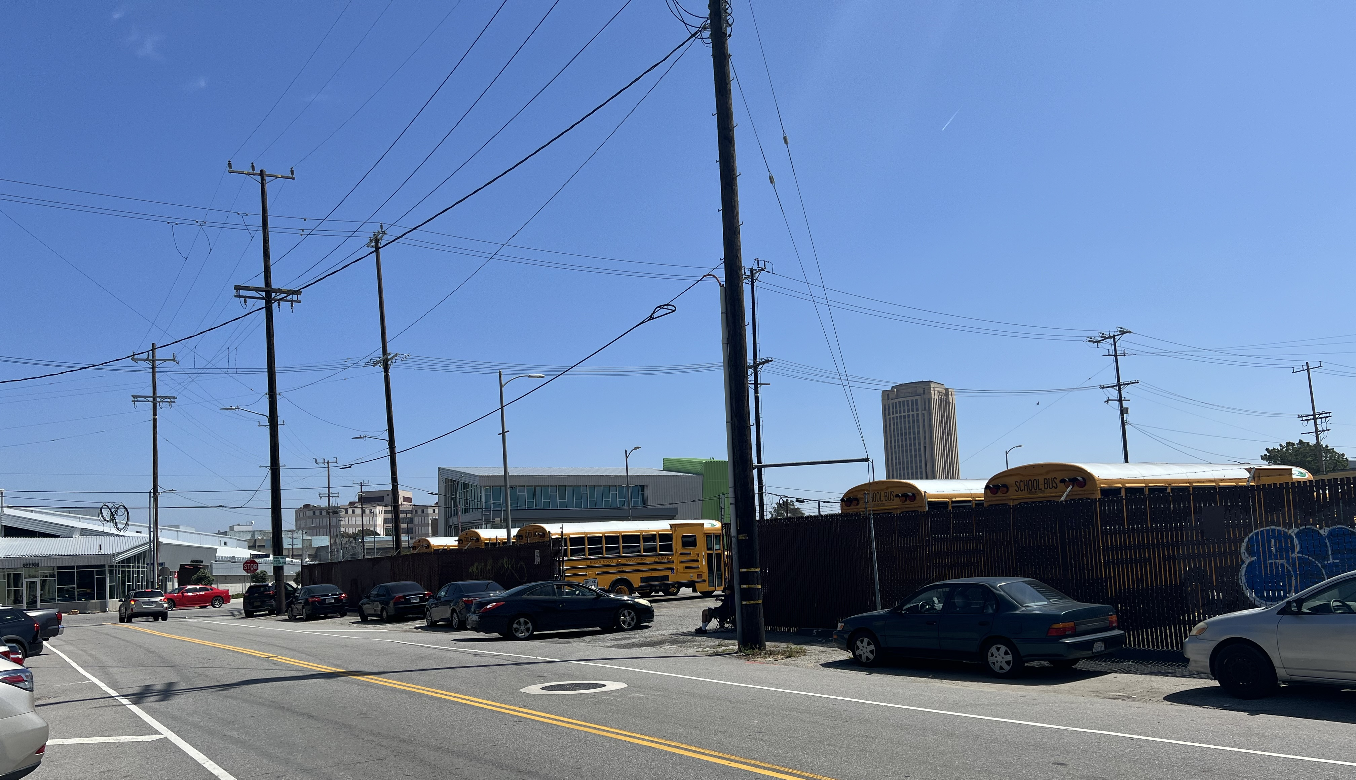
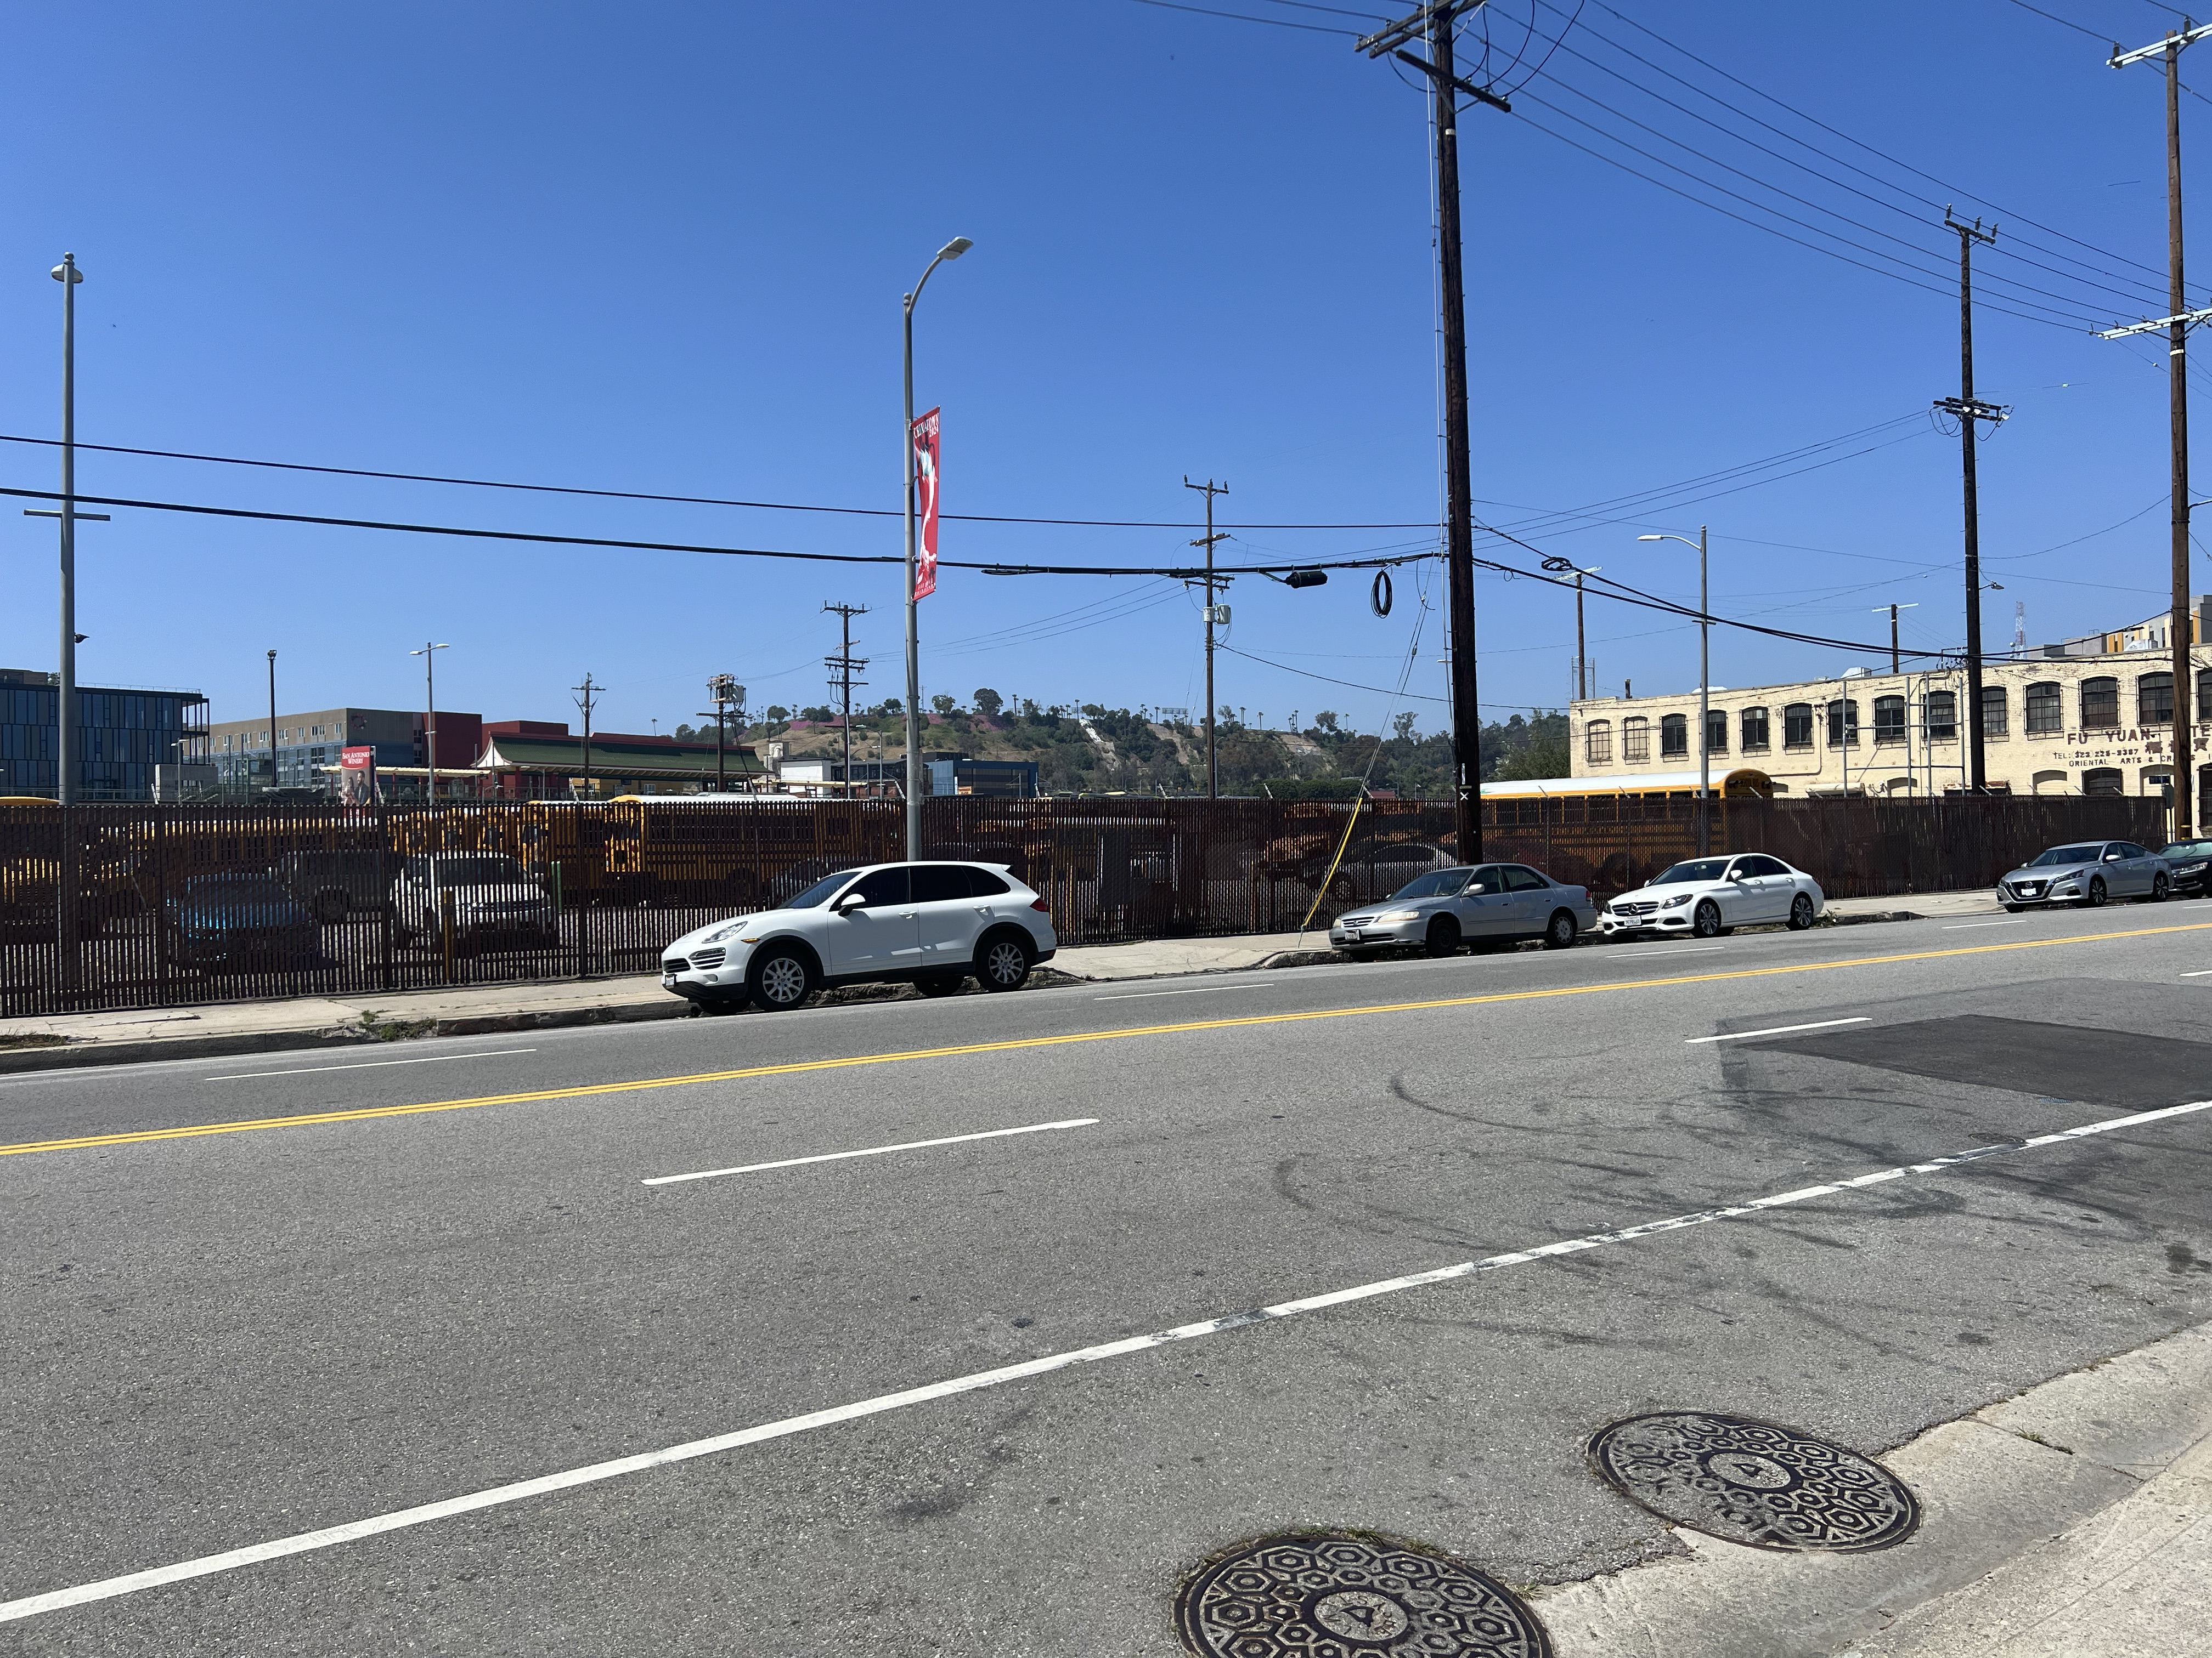
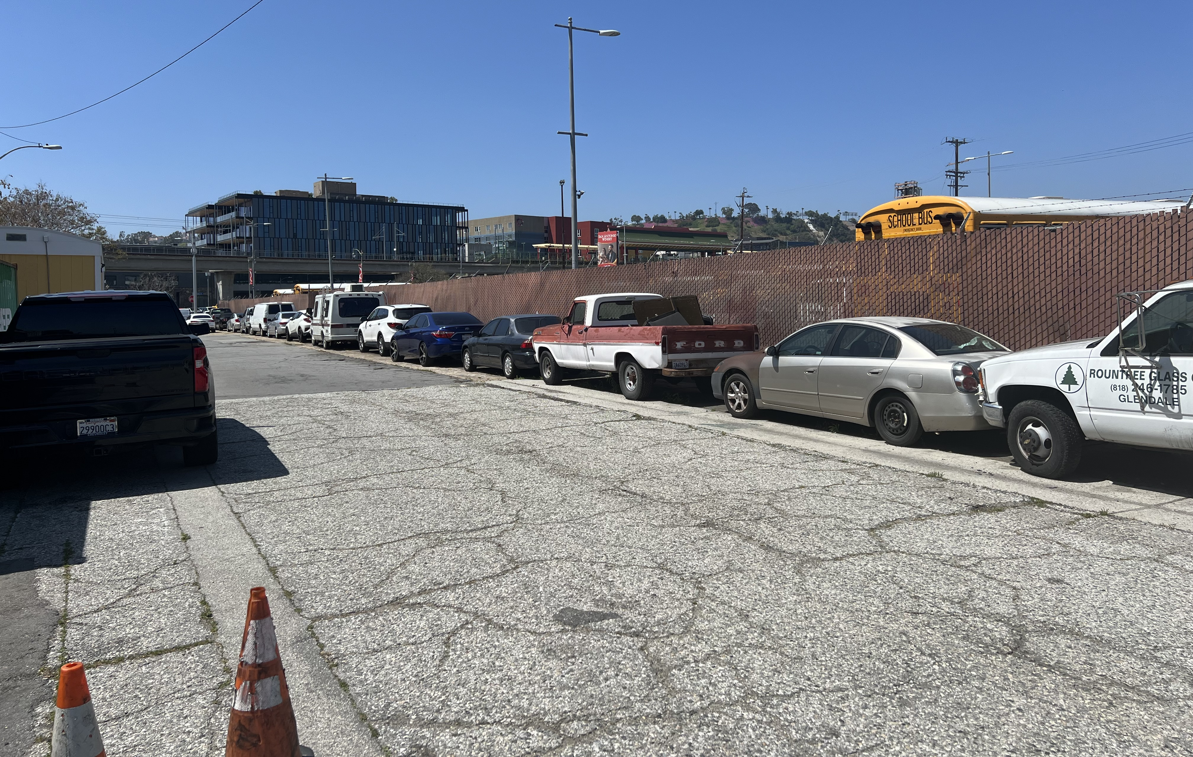
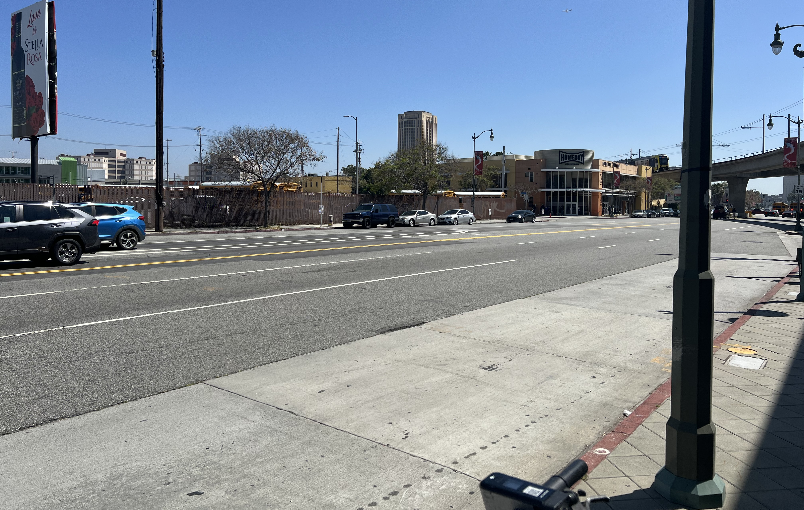
Existing Conditions
View from College St
View from Main St
Romaine St.
Hudson Ave.
View from Bruno St
View from Alameda St

Slide 8
Project Overview
Construction of a 232,802 sf, five-story infill project
224,597 sf office
4,095 sf restaurant
4,110 sf retail
Parking within one subterranean, one at-grade, and one above-grade mezzanine level
Additional improvements include lighting, outdoor seating, bicycle parking, and interior courtyards and gardens
Hudson Ave.

Slide 9
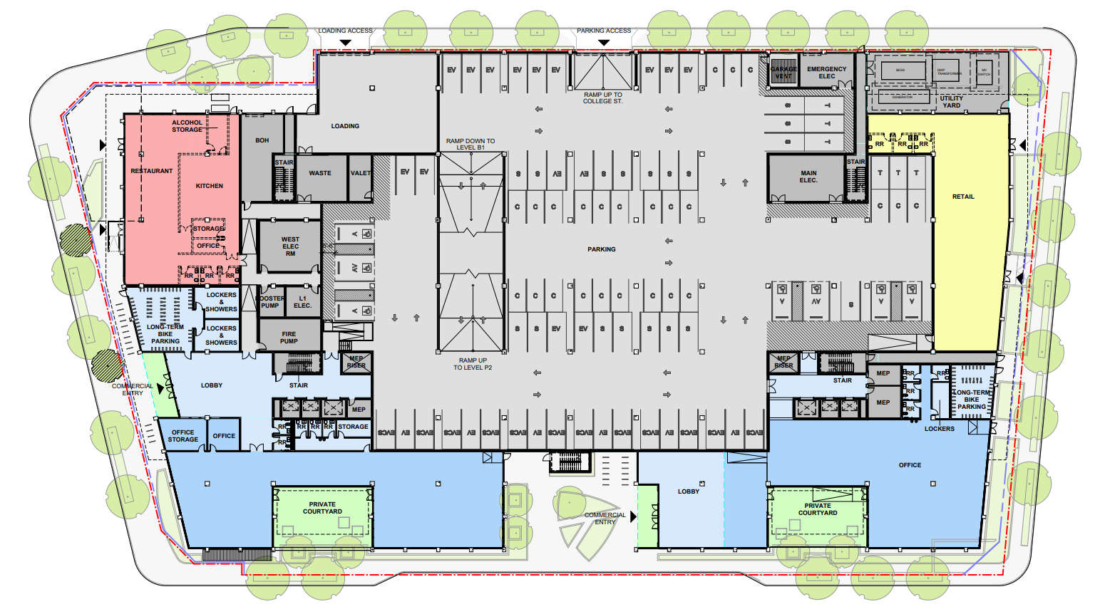
Proposed Uses
W College St.
Main St.
N Alameda St.
Bruno St.

Slide 10
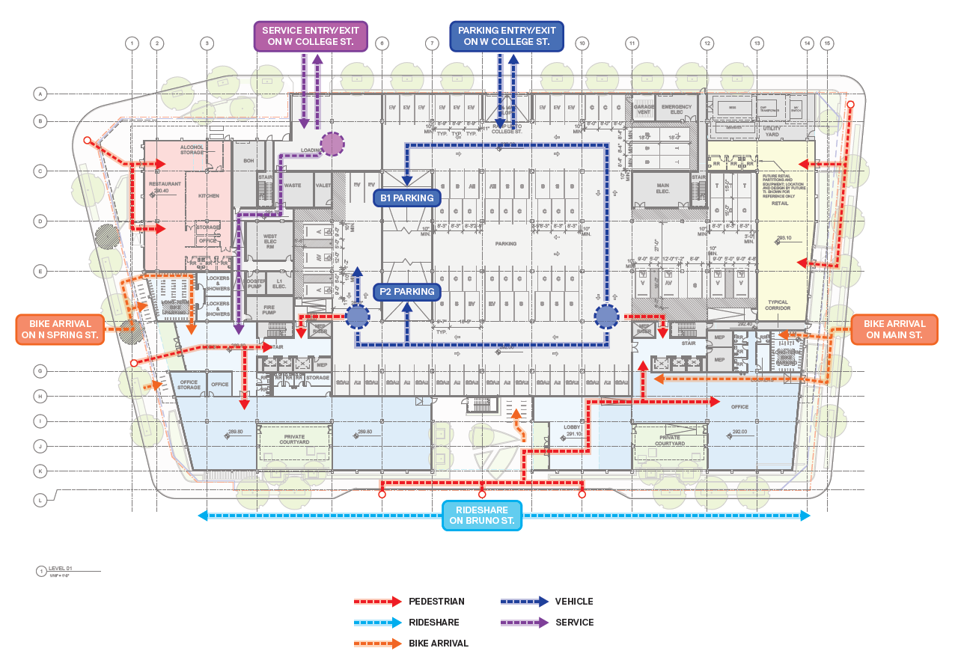
Circulation Plan
W College St.
Main St.
N Alameda St.
Bruno St.

Slide 11
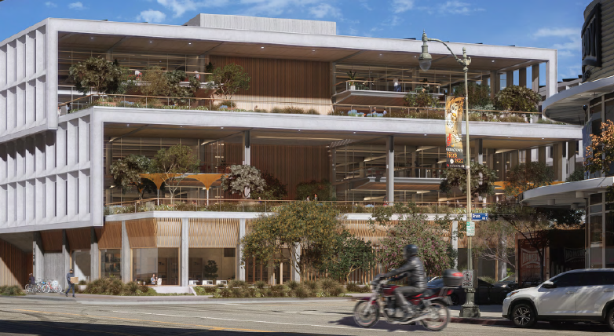
Design and Architecture
View of Southwest Corner from Alameda St and Bruno St

Slide 12
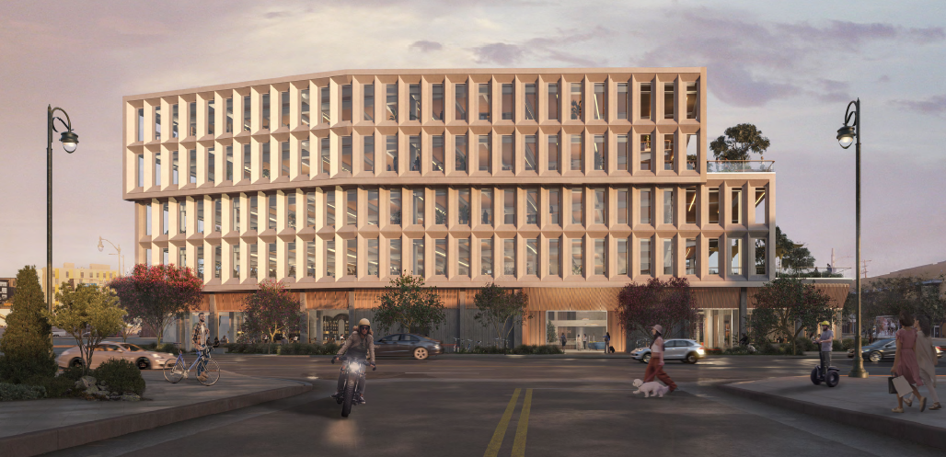
Design and Architecture
View from Alameda St

Slide 13
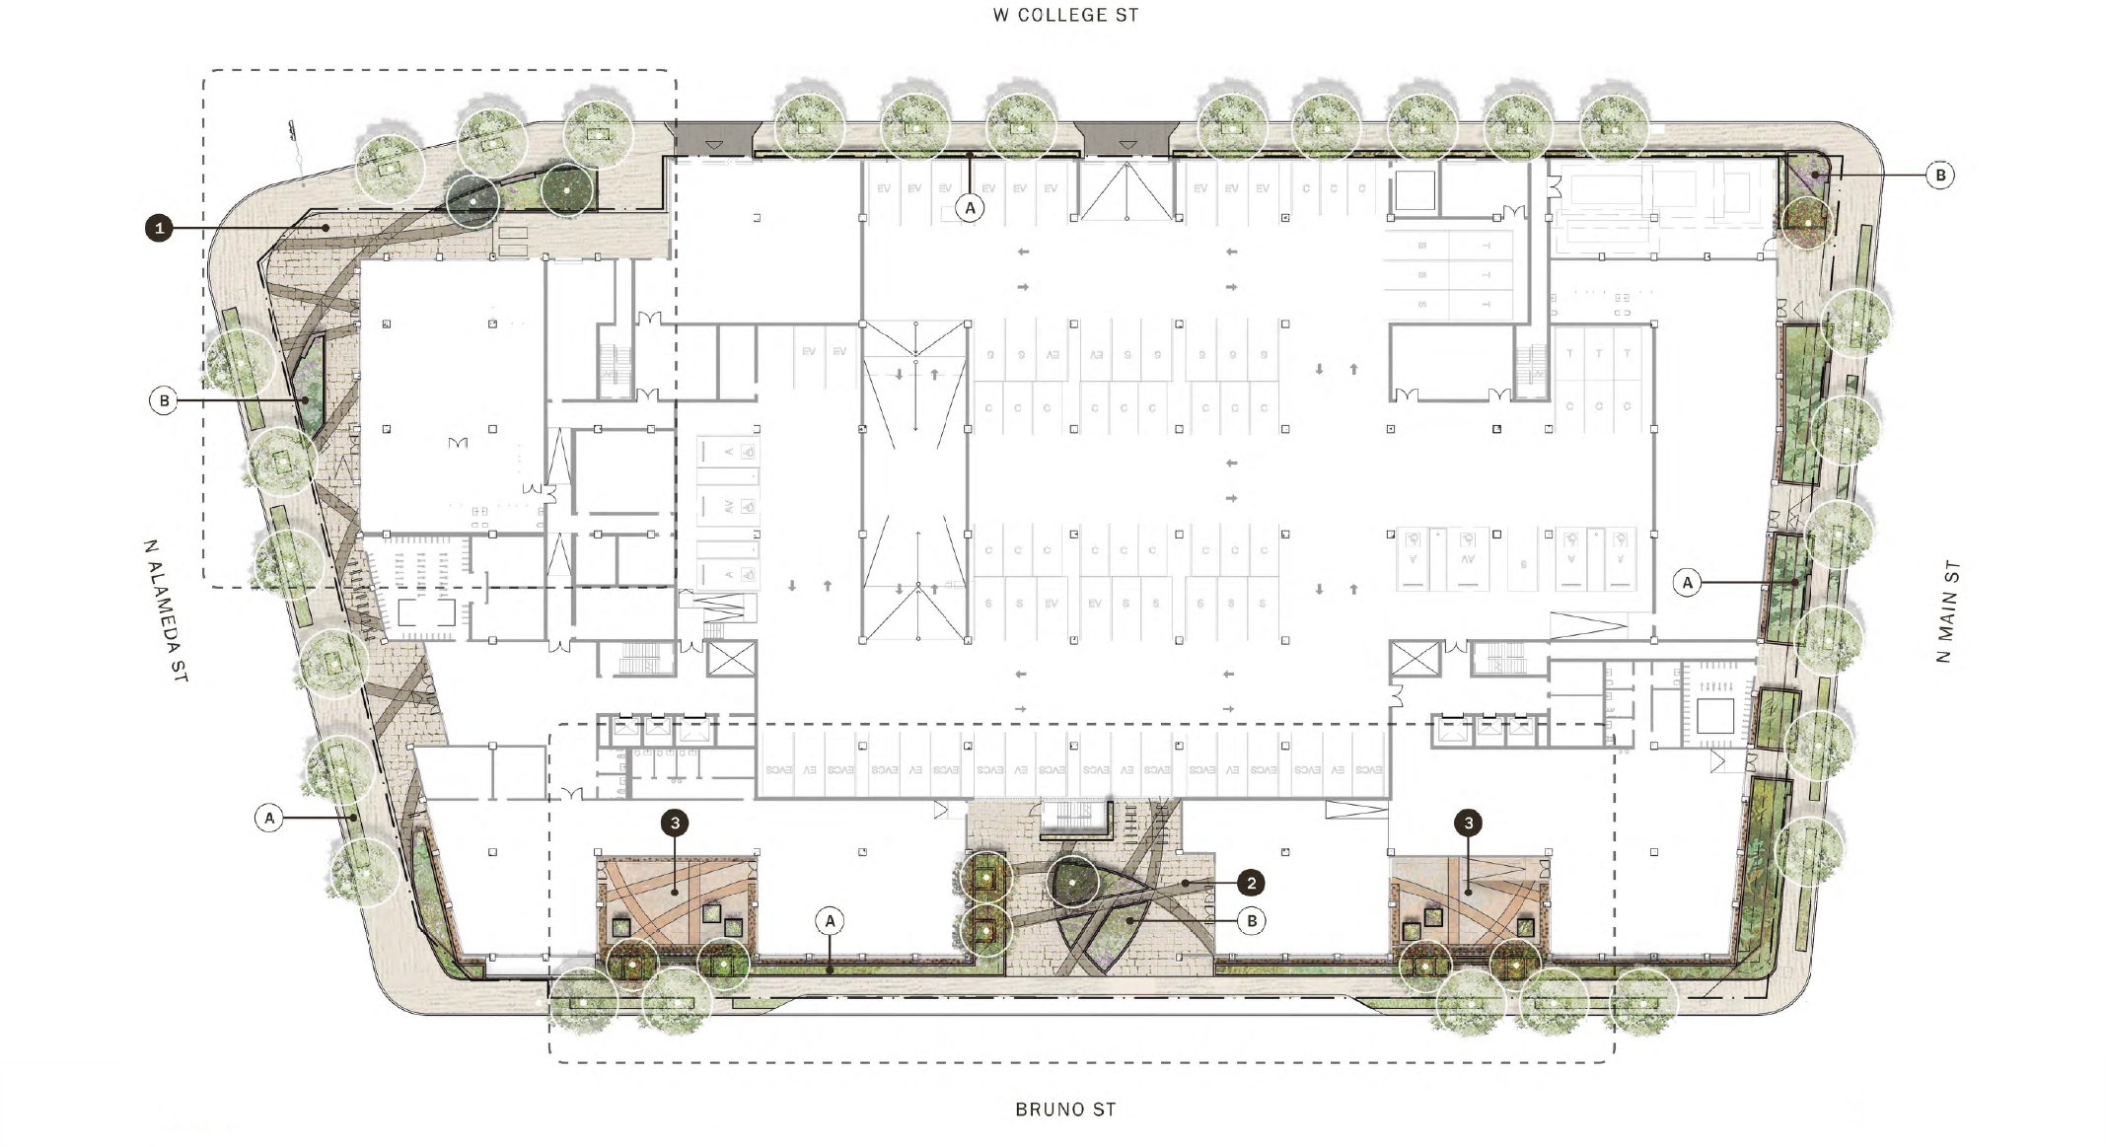
Landscape Plan

Slide 14
Project Timeline
Distribute Notice of Preparation and Initial Study (June 4, 2024)
Scoping Meeting (June 12, 2024)
Publication of Notice of Availability and Draft EIR
Draft EIR Public Comment Period
Prepare Final EIR
30-Day Review Period
Prepare Draft EIR
45-day Review Period
Public Hearings
Formal City Decision
End of NOP Public Comment Period (July 5, 2024)
Public Input Opportunities
City Internal
Today’s Meeting

Slide 15
Proposed Draft EIR Scope
Impacts Found To Be
Less Than Significant
Impacts To Be Further Analyzed in the Draft EIR
Aesthetics
Agriculture and Forestry Resources
Biological Resources
Hydrology and Water Quality
Mineral Resources
Population and Housing
Public Services (Schools, Parks, Libraries, Fire, and Police)
Recreation
Wildfire
Air Quality
Cultural Resources
Energy
Geology and Soils
Greenhouse Gas Emissions
Hazards and Hazardous Materials
Land Use and Planning
Noise
Transportation
Tribal Cultural Resources
Utilities and Service Systems

Slide 16
Requested Actions
General Plan Amendment to allow commercial FAR at the Project Site to exceed 1.5:1;
Vesting Zone and Height District Change to (T)(Q)C2-2D-RIO;
Main Conditional Use Permit for alcohol sales;
Site Plan Review for a development with 50,000 sf or more of nonresidential floor area; and
Vesting Tentative Tract Map for subdivision of the site; and a Haul Route for soil export;

Slide 17
How to Submit Public Comment
Through mail:
Attn: Michael Gatheru
City of Los Angeles
Department of City Planning
221 N Figueroa St, Ste 1350
Los Angeles, CA 90012
Reference:
130 College Project
Case No. ENV-2023-2307-EIR
Through email:
michael.gatheru@lacity.org
All written comments must be submitted by: July 05, 2024, 4:30 p.m.
For more information about the Project please visit: https://planning.lacity.gov/development-services/eir/130-College-project
Submitting a question or comment during the following Q & A portion of the meeting DOES NOT constitute a formal written comment to be included as part of the NOP comment period.

Slide 18
Meeting Participation
Via Zoom: Use the “raise hand” icon and Staff will say your name (as listed on Zoom) and unmute you when it is your turn in the queue to speak.
Via Telephone: Press *9 to “raise hand” and Staff will say the last 4 digits of your phone number when it is your turn in the queue to speak, press *6 when prompted to unmute yourself

Slide 19
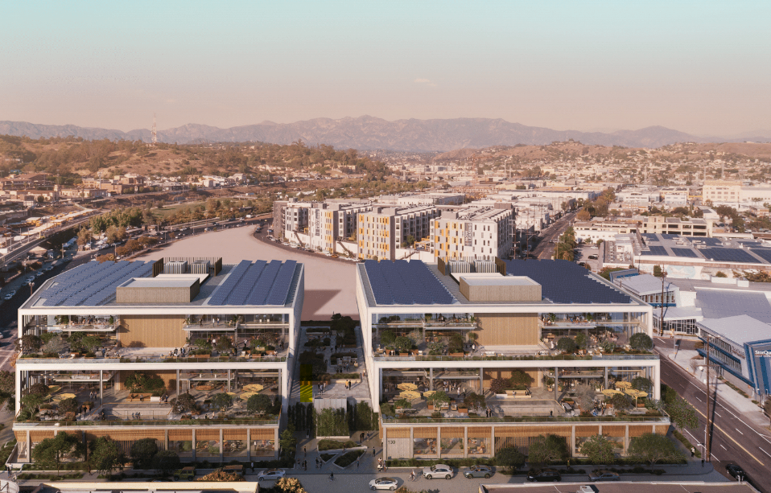
Q&A

